Slide 1
Chapter 6: Momentum Analysis of Flow Systems
Chao-Lung Ting
Department of Engineering Science and Ocean Engineering
National Taiwan University
Fall 2014

Slide 2
Introduction
Most engineering problems can be analyzed using one of three basic approaches: differential, experimental, and control volume.
  Differential approaches: the problem is formulated accurately using differential quantities, but the solution is usually relied on the use of numerical methods.
  Experimental approaches: complemented with dimensional analysis are highly accurate, but they are typically time consuming and expensive.
  Finite control volume approach: described in this chapter is remarkably fast and simple and usually gives answers that are sufficiently accurate for most engineering purposes.
The linear momentum and angular momentum equations for control volumes were developed and use them to determine the forces and torques associated with fluid flow.

Slide 3

NEWTON’S LAWS AND CONSERVATION
OF MOMENTUM
Newton’s Law
  Newton’s first law
  Newton’s second law.
  Newton’s third law.
For a rigid body of mass m, Newton’s second law is expressed as

Slide 4
NEWTON’S LAWS AND CONSERVATION
OF MOMENTUM
The product of the mass and the velocity of a body is called the linear momentum or just the momentum of the body.
Therefore, Newton’s second law can also be stated as the rate of change of the momentum of a body is equal to the net force acting on the body
Newton’s second law ⇒ the linear momentum equation in fluid mechanics
The momentum of a system is conserved when it remains constant ⇒ the conservation of momentum principle.
Momentum is a vector. Its direction is the direction of velocity.

Slide 5

NEWTON’S LAWS AND CONSERVATION
OF MOMENTUM
Newton’s second law for rotating rigid bodies is expressed as
where is the net moment or torque applied on the body, I is the moment of inertia of the body about the axis of rotation, and is the angular acceleration.

Slide 6

NEWTON’S LAWS AND CONSERVATION
OF MOMENTUM
The rate of change of angular momentum is
The rate of change of the angular momentum of a body is equal to the net torque acting on it
The conservation of angular momentum principle is hold as
Where is the angular velocity.

Slide 7
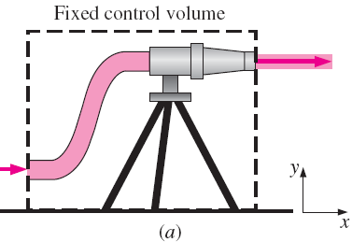
CHOOSING A CONTROL VOLUME
How to wisely select a control volume?
A control volume can be selected as any arbitrary region in space through which fluid flows.
A control volume and its bounding control surface can be fixed, moving, and even deforming during flow.

Slide 8
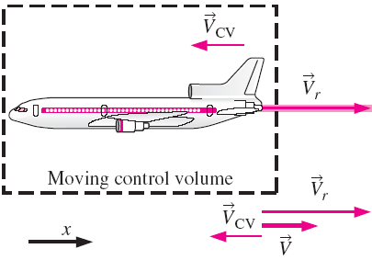
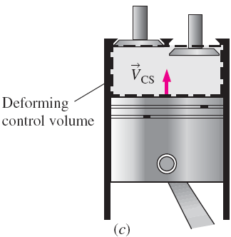


CHOOSING A CONTROL VOLUME
for moving but nondeforming control volumes
= 0 for fixed ones

Slide 9
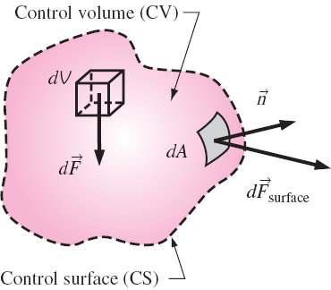

FORCES ACTING ON A CONTROL VOLUME
The forces include:
  Body forces: act throughout the entire body of the control volume (such as gravity, electric, and magnetic forces)
  Surface forces: act on the control surface (such as pressure and viscous forces and reaction forces at points of contact).
Total force acting on control volume is expressed as

Slide 10
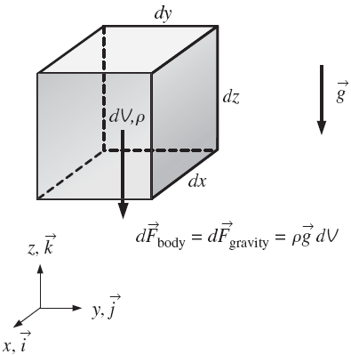




Body Forces
Body force: the only body force considered in this text is gravity
where
Therefore, the total body force is
On earth at sea level, the gravitational constant g is equal to 9.807 m/s².

Slide 11
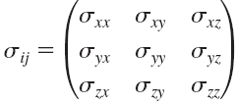
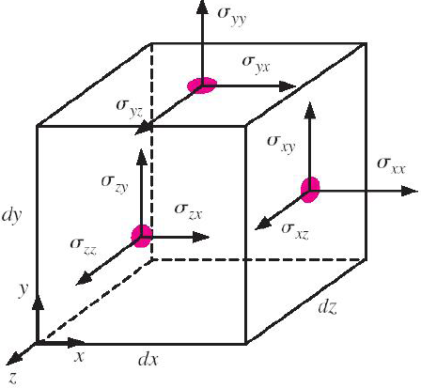
Surface Forces
Surface forces: are not as simple to analyze since they consist of both normal and tangential components.
Diagonal components σ_{xx} , σ_{yy} , σ_{zz} are called normal stresses and are due to pressure and viscous stresses.
Off-diagonal components σ_{xy}, σ_{xz}, etc. are called shear stresses and are due solely to viscous stresses.

Slide 12
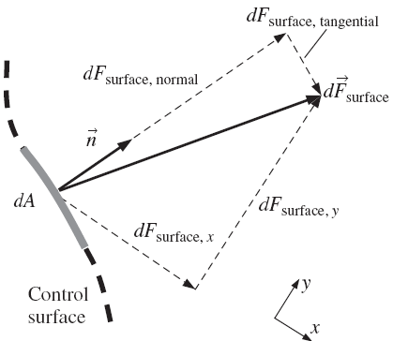
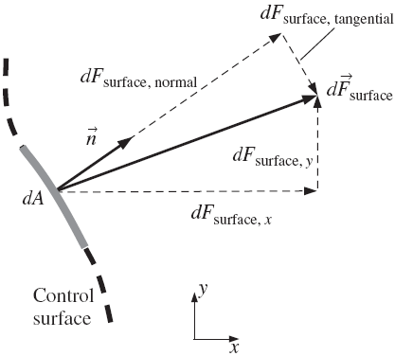
Surface Forces
The physical force acting on a surface is independent of orientation of the coordinate axes.

Slide 13


Surface Forces
The dot product of a second-order tensor and a vector yields a second vector whose direction is the direction of the surface force itself.
Surface force acting on a differential surface element:
Total surface force acting on CS

Slide 14

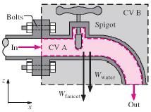
FORCES ACTING ON A CONTROL VOLUME
Total force:
The control volume is drawn similar to drawing a free-body diagram in your statics and dynamics classes.
Which one (CV A and CV B) is a wise choice if we want to calculate the force on the flange?

Slide 15
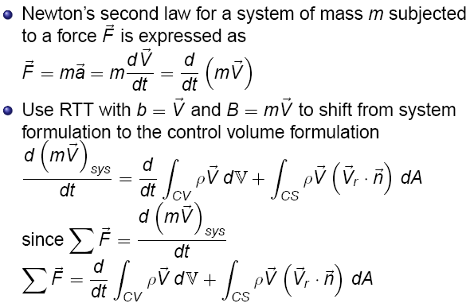
THE LINEAR MOMENTUM EQUATION

Slide 16
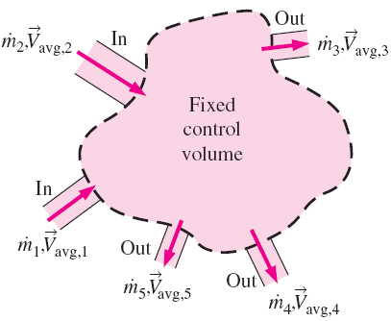


THE LINEAR MOMENTUM EQUATION
-Special Cases
During steady flow, the amount of momentum within the control volume remains constant. The linear momentum equation becomes
Momentum flow rate across a uniform inlet or outlet in algebraic form:

Slide 17



Momentum-Flux Correction Factor, β
Since the velocity across most inlets and outlets is not uniform, the momentum-flux correction factor, β, is used to patch-up the error in the algebraic form equation. Therefore,
Momentum flux across an inlet or outlet:
Momentum-flux correction factor:

Slide 18

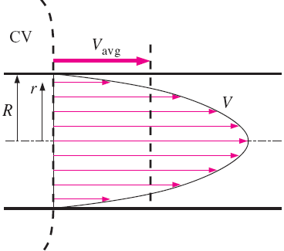


EXAMPLE: Momentum-Flux Correction
Factor for Laminar Pipe Flow
Consider laminar flow through a very long straight section of round pipe. The velocity profile through a cross-sectional area of the pipe is
Calculate the momentum-flux correction factor through a cross section of the pipe
Solution:
Note: For turbulent flow β may have an insignificant effect at inlets and outlets, but for laminar flow β may be important and should not be neglected.

Slide 19
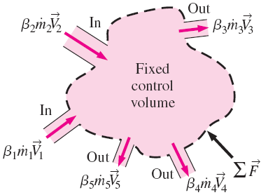


Steady linear momentum equation
The net force acting on the control volume during steady flow is equal to the difference between the rates of outgoing and incoming momentum flows. Therefore,
One inlet and one outlet:

Slide 20


Flow with No External Forces
This is a common situation for space vehicles and satellites.
For a control volume with multiple inlets and outlets, the linear momentum equation is
This is an expression of the conservation of momentum principle.
If m remains nearly constant, then

Slide 21
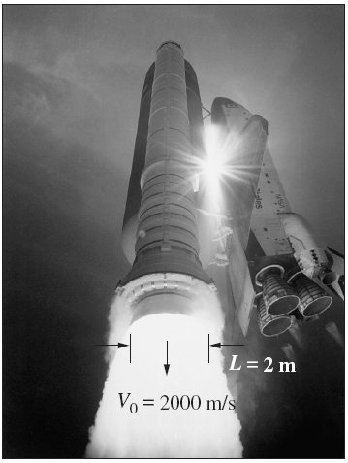

Flow with No External Forces
In this case, the control volume can be treated as a solid body, with a thrust of
This approach can be used to determine the linear acceleration of space vehicles when a rocket is fired.

Slide 22
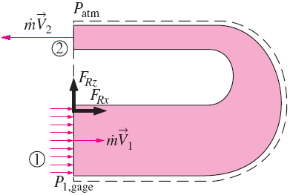
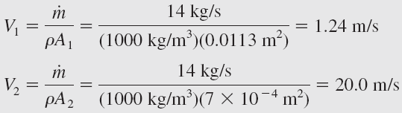


EXAMPLE: The Force to Hold a
Reversing Elbow in Place
A reversing elbow Makes the fluid a 180° U-turn before it is discharged at a rate of 14 kg/s, The cross-sectional area of the elbow is 113 cm² at the inlet and 7 cm² at the outlet. The elevation difference between the centers of the inlet and the exit sections is still 0.3 m. Determine the anchoring force needed to hold the elbow in place. (the weight of the elbow and the water are neglected)
Solution:
The vertical component of the anchoring force at the connection of the elbow to the pipe is zero, since weight is neglected. Only the F_{Rx} is considered.
Where β is 1.03.

Slide 23
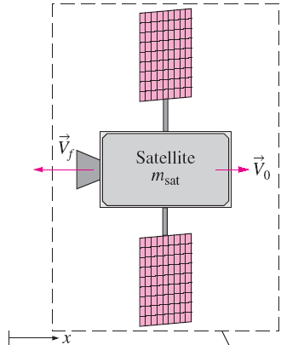






EXAMPLE: Repositioning of a Satellite
Solution:
An orbiting satellite has a mass of m_{sat} = 5000 kg and is traveling at a constant velocity of V₀. To alter its orbit, an attached rocket discharges m_{f} = 100 kg of gases from the reaction of solid fuel at a velocity V_{f} = 3000 m/s relative to the satellite in a direction opposite to V₀. The fuel discharge rate is constant for 2 s. Determine (a) the acceleration of the satellite during this 2-s period, (b) the change of velocity of the satellite during this time period, and (c) the thrust exerted on the satellite.
The thrust exerted on the satellite is

Slide 24
REVIEW OF ROTATIONAL MOTION
AND ANGULAR MOMENTUM
The motion of a rigid body:
(Translation of + Rotation about) the center of mass.
The translational motion can be analyzed using the linear momentum equation.
Rotational motion is described with angular quantities such as the angular distance θ, angular velocity ϖ, and angular acceleration α.

Slide 25
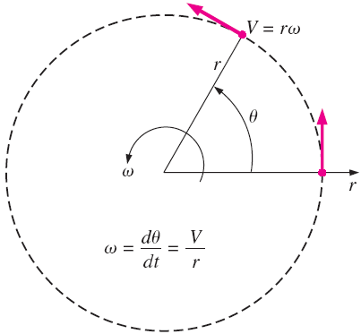




REVIEW OF ROTATIONAL MOTION
AND ANGULAR MOMENTUM
where V is the linear velocity and a_{t} is the linear acceleration in the tangential direction for a point located at a distance r from the axis of rotation.
1 rad =

Slide 26
Moment or Torque
Newton’s second law requires that there must be a force acting in the tangential direction to cause angular acceleration.
The strength of the rotating effect, called the moment or torque, is proportional to the magnitude of the force and its distance from the axis of rotation.
The perpendicular distance from the axis of rotation to the line of action of the force is called the moment arm.
The torque M acting on a point mass m at a normal distance r from the axis of rotation is expressed as

Slide 27

Moment or Torque
The total torque acting on a rotating rigid body about an axis can be determined by
where I is the moment of inertia of the body about the axis of rotation, which is a measure of the inertia of a body against rotation.
Note that unlike mass, the rotational inertia of a body also depends on the distribution of the mass of the body with respect to the axis of rotation.

Slide 28
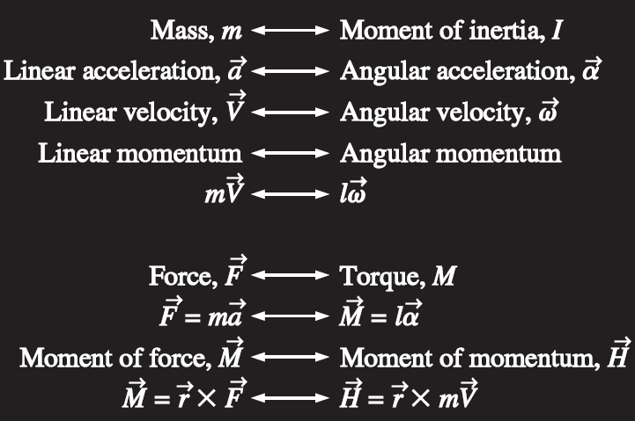
Analogy between corresponding linear and angular quantities.

Slide 29
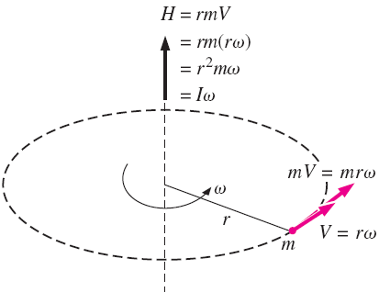


Angular momentum
The moment of momentum, called the angular momentum, of a point mass m about an axis can be expressed as
the total angular momentum of a rotating rigid body can be determined by integration to be

Slide 30


Angular momentum
The vector form of angular momentum can be expressed as
Note that the angular velocity is the same at every point of a rigid body.
The moment, the rate of change of angular momentum, is

Slide 31
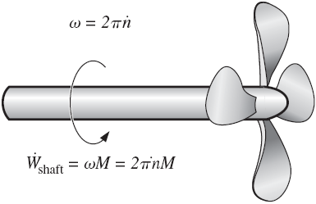

Shaft power
The angular velocity of rotating machinery is typically expressed in rpm and denoted by .
The angular velocity of rotating machinery is
The power transmitted by a shaft rotating at an rpm of under the influence of an applied torque M is
(rad/min)

Slide 32


Rotational kinetic energy
The rotational kinetic energy of a body of mass m at a distance r from the axis of rotation is
The total rotational kinetic energy of a rotating rigid body about an axis can be determined by

Slide 33



Centripetal acceleration and force
During rotational motion, the direction of velocity changes even when its magnitude remains constant.
The centripetal acceleration changes the direction of the velocity. Its magnitude is
Centripetal acceleration is directed toward the axis of rotation. The centripetal force, which induces the acceleration, is
Tangential and radial accelerations are perpendicular to each other, and the total linear acceleration is determined by their vector sum,

Slide 34
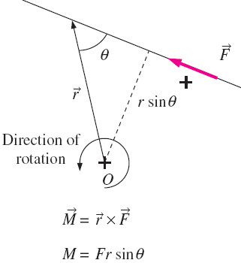

THE ANGULAR MOMENTUM EQUATION
Many engineering problems involve the moment of the linear momentum of flow streams, and the rotational effects caused by them, which are best analyzed by the angular momentum equation,
The moment of a force about a point O is the vector (or cross) product.
Whose magnitude is

Slide 35
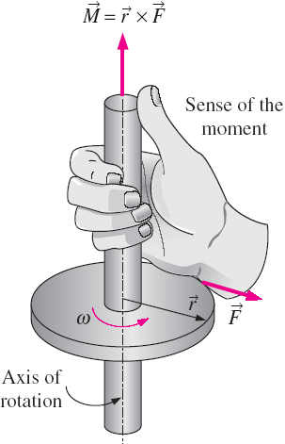




THE ANGULAR MOMENTUM EQUATION
The sense of the moment vector is determined by the right-hand rule
Replacing the vector by the momentum vector gives the moment of momentum, also called the angular momentum
The angular momentum of a differential mass dm is
Moment of momentum (system):

Slide 36


THE ANGULAR MOMENTUM EQUATION
Rate of change of moment of momentum:
The rate of change of angular momentum of a system is equal to the net torque acting on the system (valid for a fixed quantity of mass and an inertial reference frame).

Slide 37
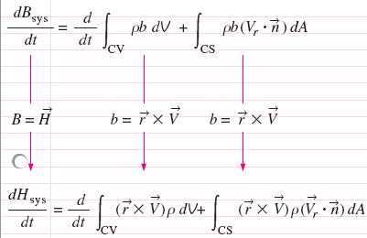


THE ANGULAR MOMENTUM EQUATION
Applying the RTT

Slide 38



THE ANGULAR MOMENTUM EQUATION -Special Cases
Steady Flow:
In many practical applications, an approximate form of the angular momentum equation in terms of average properties at inlets and outlets becomes
No correction factor is introduced since it varies from problem to problem and the induced error is small.
Steady Flow

Slide 39



Flow with No External Moments
When there are no external moments applied, the angular momentum equation reduces to
When the moment of inertia I of the control volume remains constant, then

Slide 40
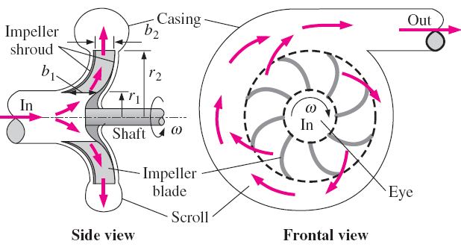
Radial-Flow Devices
Flow in the radial direction normal to the axis of rotation and are called radial flow devices.
In a centrifugal pump, the fluid enters the device in the axial direction through the eye of the impeller, and is discharged in the tangential direction.

Slide 41
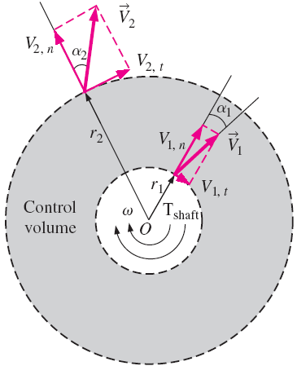
Radial-Flow Devices
Consider a centrifugal pump. The impeller section is enclosed in the control volume.
The average flow velocity, in general, has normal and tangential components at both the inlet and the outlet of the impeller section.
when the shaft rotates at an angular velocity of ϖ, the impeller blades have a tangential velocity of ϖr₁ at the inlet and ϖr₂ at the outlet.

Slide 42



Radial-Flow Devices
The conservation of mass equation tells
where b₁ and b₂ are the flow widths at the inlet and outlet.
Then the average normal components are

Slide 43



Radial-Flow Devices
The normal velocity components and pressure act through the shaft center and contribute no torque. Only the tangential velocity components contribute to the angular momentum equation, which gives the famous Euler’s turbine formula.
In the idealized case,
The shaft power

Slide 44
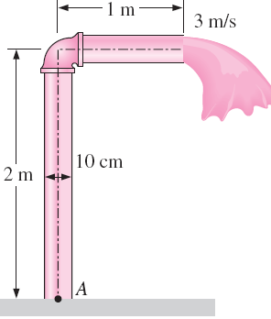
EXAMPLE: Bending Moment Acting at the
Base of a Water Pipe
Underground water is pumped to a sufficient height through a 10-cm diameter pipe that consists of a 2-m-long vertical and 1-m-long horizontal section. Water discharges to atmospheric air at an average velocity of 3 m/s, and the mass of the horizontal pipe section when filled with water is 12 kg per meter length. The pipe is anchored on the ground by a concrete base. Determine the bending moment acting at the base of the pipe (point A) and the required length of the horizontal section that would make the moment at point A zero.

Slide 45
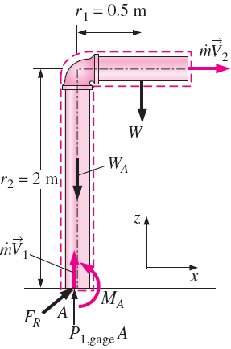

EXAMPLE: Bending Moment Acting at the
Base of a Water Pipe
Solution
Conservation of mass gives
Therefore, we can get
Then the angular momentum equation about point A becomes

Slide 46



EXAMPLE: Bending Moment Acting at the
Base of a Water Pipe
Therefore,
Setting M_{A} = 0, then we can get

Slide 47
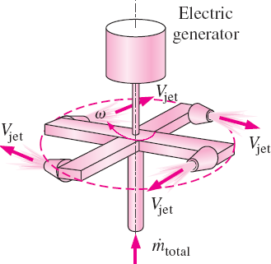
EXAMPLE: Power Generation from a
Sprinkler System
A large lawn sprinkler with four identical arms is to be converted into a turbine to generate electric power by attaching a generator to its rotating head. Water enters the sprinkler from the base along the axis of rotation at a rate of 20 L/s and leaves the nozzles in the tangential direction. The sprinkler rotates at a rate of 300 rpm in a horizontal plane. The diameter of each jet is 1 cm, and the normal distance between the axis of rotation and the center of each nozzle is 0.6 m. Estimate the electric power produced.

Slide 48
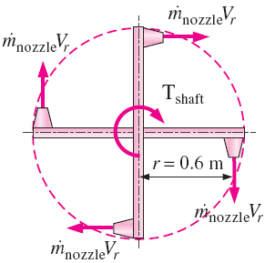





EXAMPLE: Power Generation from a
Sprinkler System
Solution

Slide 49



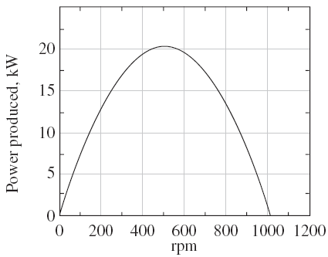
EXAMPLE: Power Generation from a
Sprinkler System
Discussion of two limiting cases

